Slide 1
McDonald’s, Taco Bell or Panda Express
INF 550 Project Midterm Presentation

Slide 5
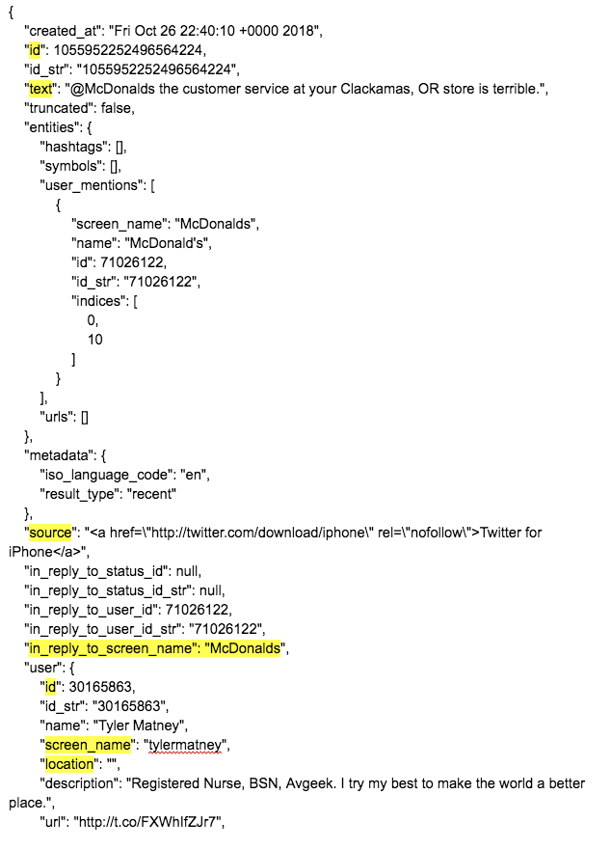
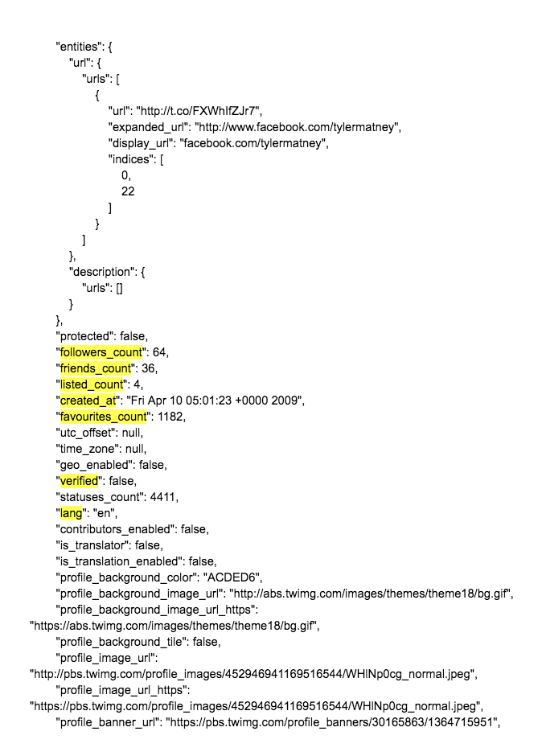
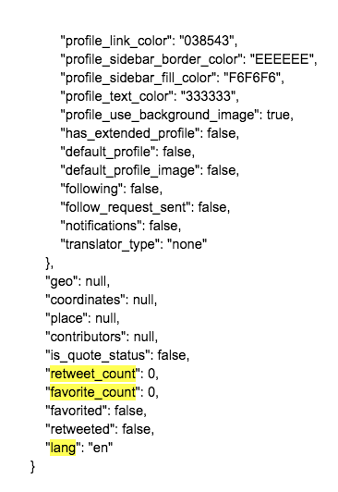
Get the data

Slide 6
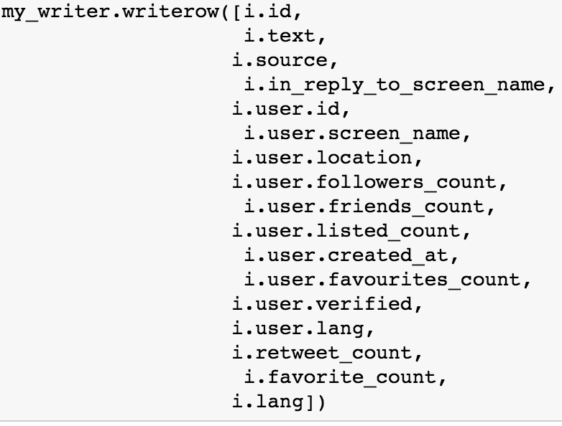
Features we select

Slide 9
Problems with sentiment analysis
Tweets from McDonald’s
Remedy: drop records created by McDonald’s Official Accounts (screen names contain “McDonalds”)

Slide 10
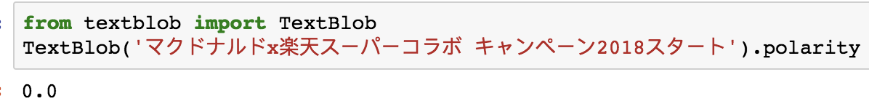
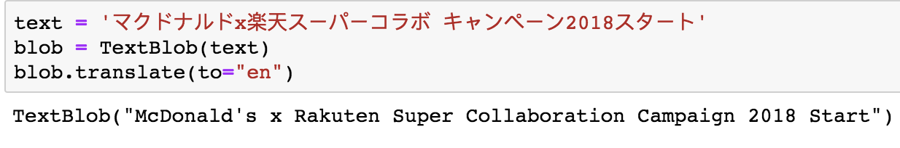
Problems with sentiment analysis
Language
TextBlob does have a translate function, connected with Google Translate API, which is limited times (1000 words a day)
Remedy: select only English records

Slide 11
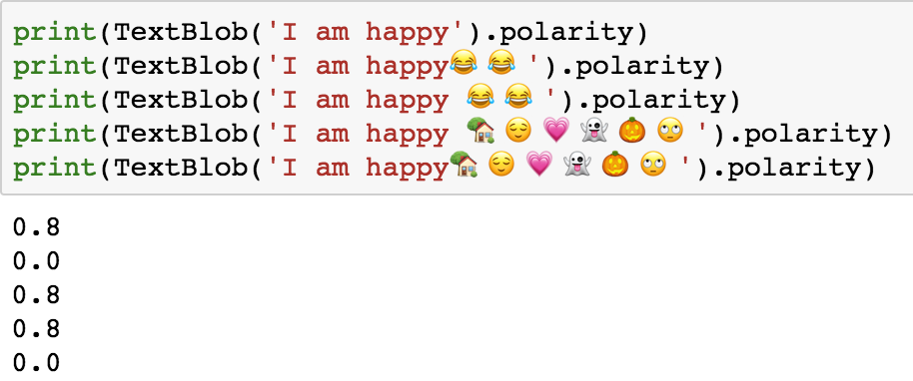
Problems with sentiment analysis
Emojis
Remedy: do sentiment analysis only on the text

Slide 12
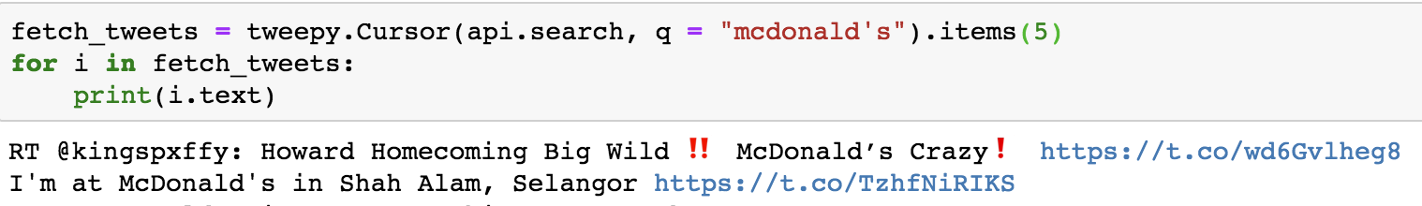
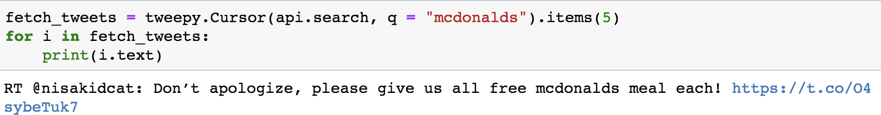
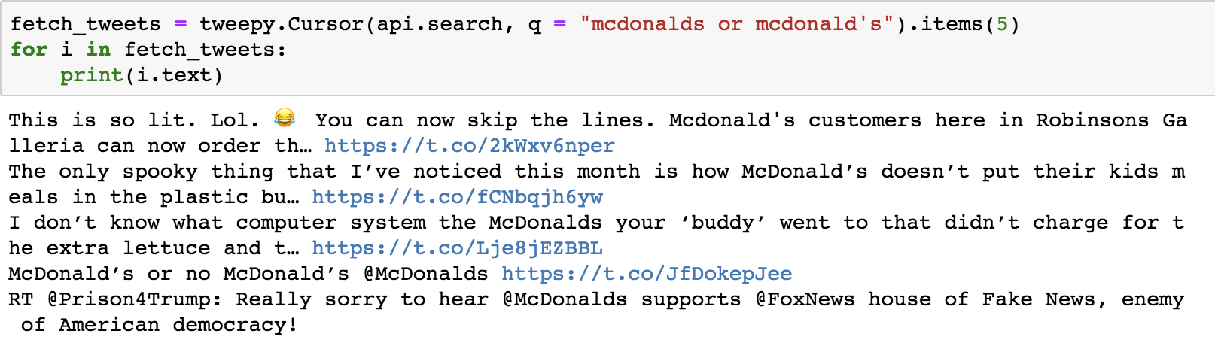
Problems with sentiment analysis

